Slide 1
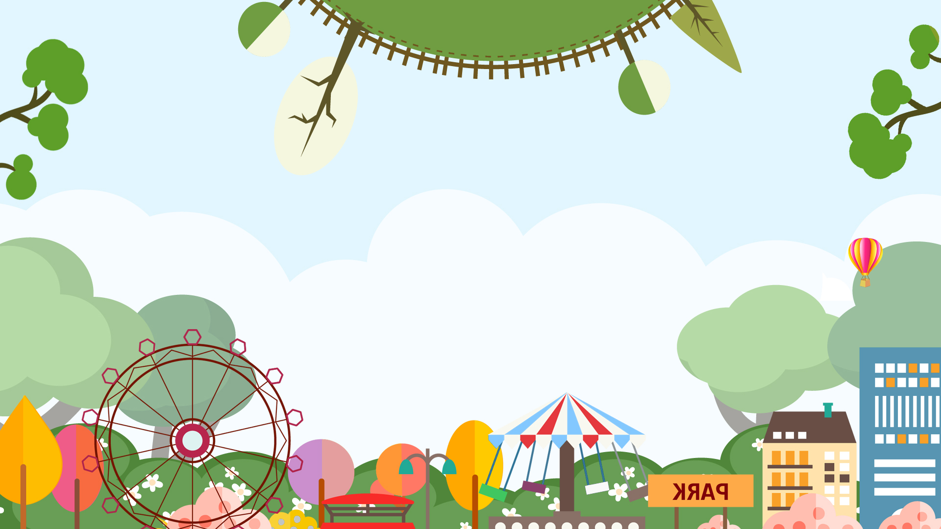
Welcome to our class

Slide 2
Content
ONE: WARM-UP
THREE: NEW LESSON
TWO: NEW WORDS
FOUR: EXPENSION

Slide 3
ONE
WARM-UP

Slide 4
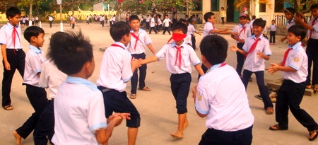
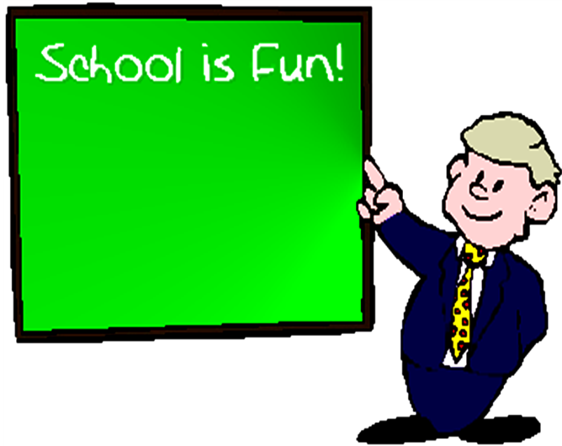
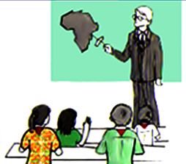
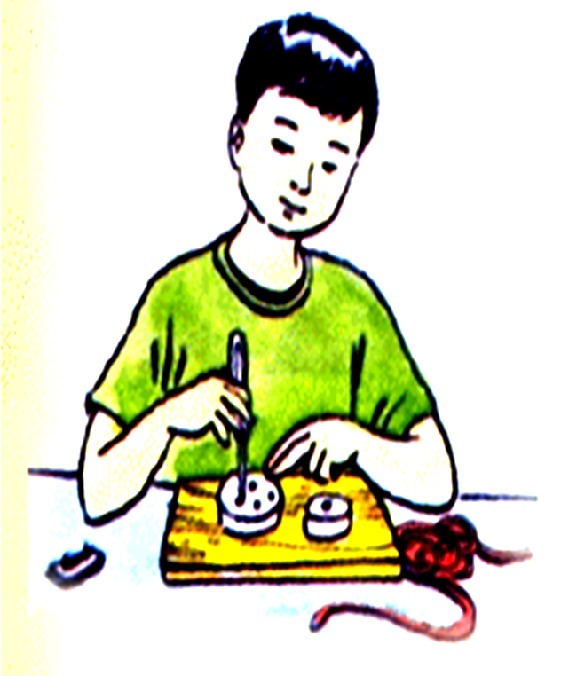
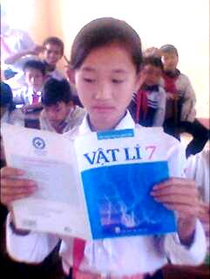
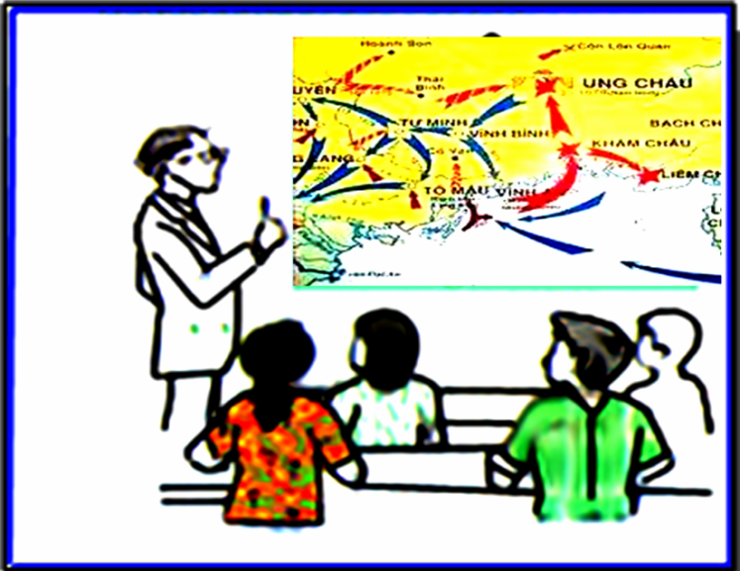
1
G
E
O
G
R
R
A
P
H
Y
2
E
L
E
E
C
T
R
O
N
I
C
S
P
H
Y
S
I
C
3
C
S
4
E
E
N
G
L
I
S
H
5
H
I
S
S
T
O
R
Y
6
C
L
A
S
S
S
E
S
K
R
E
C
E
S
S
7 letters: Which subject do they learn?
9 letters: Which subject do they learn?
7 letters: ….. always begin at 7 o’clock
in the morning and finish at 11.15
11 letters: What is he studying ?
7 letters: Which subject do they learn?
7 letters: Which subject do they learn?

Slide 5
Unit 5
Part B. IT’S TIME FOR RECESS
Lesson: 4 B1

Slide 6
TWO
NEW WORDS

Slide 7
play blindman’s bluff

Slide 8
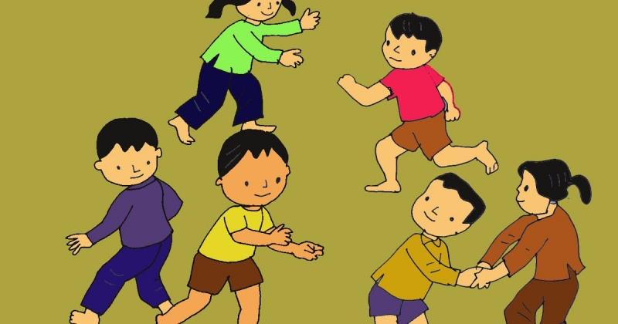
catch (n) →play catch (v)

Slide 9
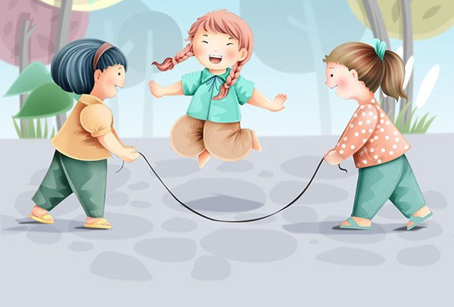
skip rope (v)

Slide 10
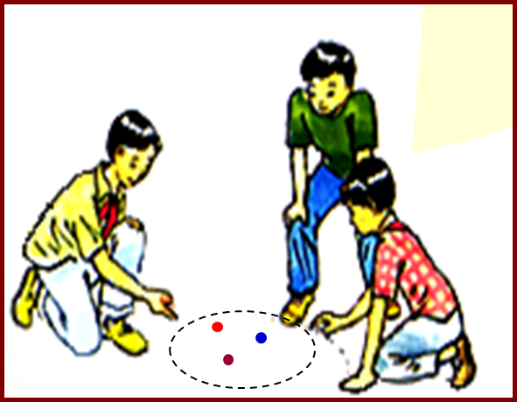
play marbles (v)

Slide 11
chat (v)

Slide 12
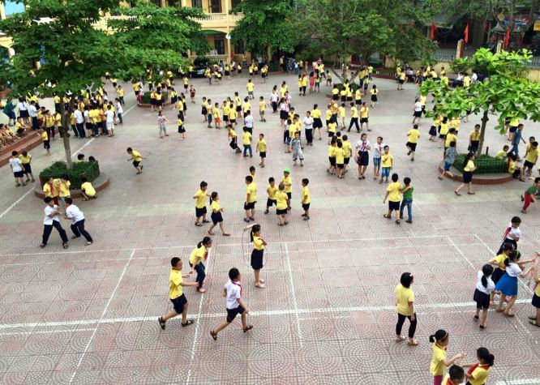
recess (n)

Slide 13
NEW WORDS
- play blindman’s bluff (v)
chơi bịt mắt bắt dê.
catch (n)
→play catch (v)
trò đuổi bắt
chơi đuổi bắt
- play marbles (v)
chơi bắn bi
- skip rope (v) = skip (B.E)
nhảy dây
- excited (a)
hào hứng
- chat (v)
tán gẫu
- recess (n)
giờ ra chơi

Slide 14
THREE
NEW lesson

Slide 15
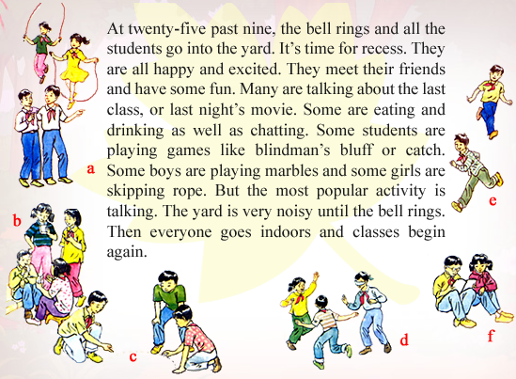
B1 Listen and read

Slide 16
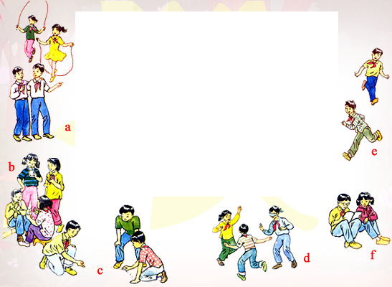
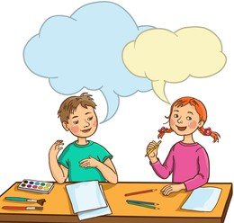
a) Now work with a partner. Ask and answer questions about the students in the picture.
What is this boy doing?
He’s playing catch

Slide 17
b) Ask and answer questions with a partner.
1. What do you usually do at recess ?
2. Do you usually talk with your friends ?
3. What do you usually do after school ?
- I usually....................................at recess.
- I usually...................................after school.

Slide 18
FOUR
EXPENSION

Slide 19
Do you know other activities in the recess?

Slide 20
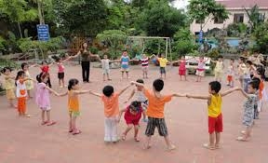
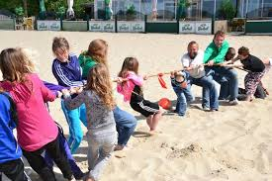
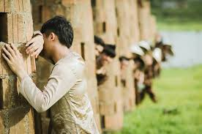
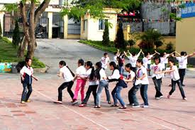
Cat and mouse game
Tug of war
Hide and seek
Dragon snake

Slide 21
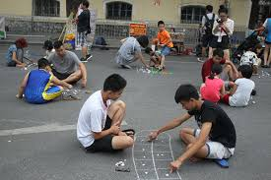
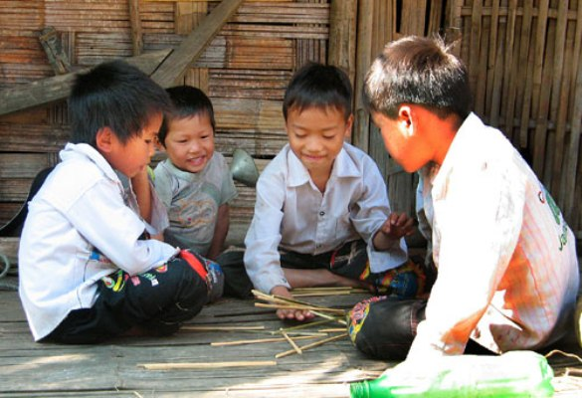
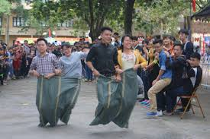
Mandarin Square capturing
Bamboo Jacks
Bag Jumping

Slide 22
HOMEWORK
Learn by heart new words.
Do exercises: B1,2 in your work book.
- Write about recess activities at your school.
- Prepare: Unit 5- Part B - B3.

Slide 23
Thank you!

